Slide 1
The Battle of the Neighborhoods –Kannur and Kozhikode

Slide 2
Introduction
Kannur and Kozhikode are two major cities in Kerala, India. Both cities become a center of attention for residential, job employment, tourism, education, and shopping and sports activity. Both cities are well known in Kerala state of India.
Brief information about both cities:
Kannur is a city and a Municipal Corporation in Kannur district, state of Kerala, India. Kannur is the largest city of North Malabar region.[1] As of 2011 census population of Kannur was 232,486.[2] Kannur is one of the million-plus urban agglomerations in India with a population of 1,642,892 in 2011. (Source: https://en.wikipedia.org/wiki/Kannur)
Kozhikode, also known as Calicut, is an Indian city, second-largest urban agglomeration in the State of Kerala and 20th largest in the country with a population of 2 million as of 2011 (Source: https://en.wikipedia.org/wiki/Kozhikode)

Slide 3
Objective
In this project, we will study in details the area classification using Foursquare data and machine learning segmentation and clustering. The aim of this project is to segment areas of Kannur and Kozhikode based on the most common places captured from Foursquare.
Using segmentation and clustering, we hope we can determine:
The similarity or dissimilarity of both cities
Classification of area located inside the city whether it is residential, tourism places, or others

Slide 4
Data
The data acquired from Wikipedia pages and google are converted to csv file for easier manipulation and reading. Both files uploaded to my GitHub for references.
Link to the files are:
https://github.com/sharikaavi/CapstoneProject/blob/master/Kannur.csv
https://github.com/sharikaavi/CapstoneProject/blob/master/Kozhikode.csv

Slide 5
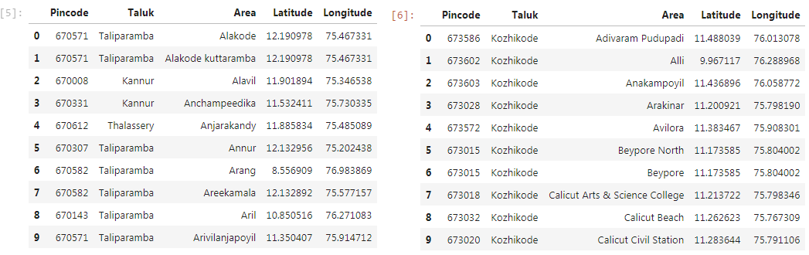
Methodology
Latitude and longitude of every area of Kannur and Kozhikode are found.
Foursquare API is used to explore neighborhoods in both cities, Kannur and Kozhikode
Most common venue categories in each neighborhood are found and then used this feature to group the neighborhoods into clusters
K-means clustering algorithm will be used to complete this task. And also, the Folium library to visualize the neighborhoods in Kannur and Kozhikode and their emerging clusters.
Taliparamba area in Kannur and Kozhikode area in Kozhikode both have the highest number of area within it those district.

Slide 6
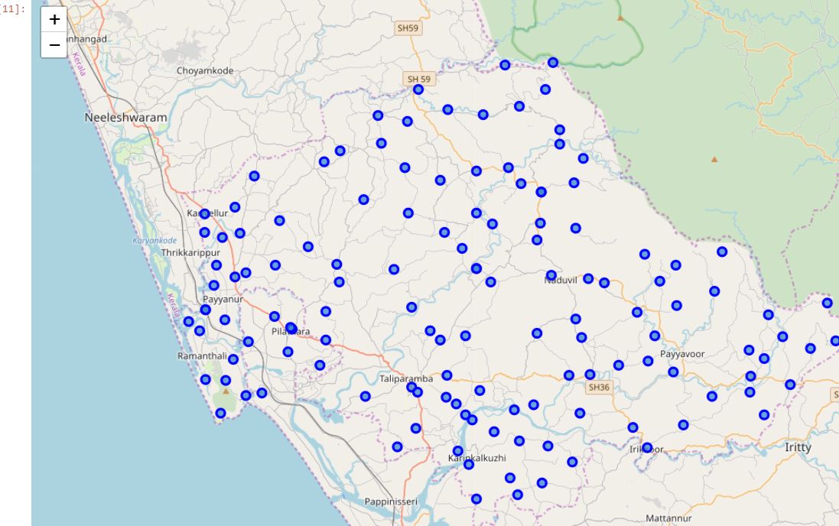
Taliparamba Area in Kannur

Slide 7
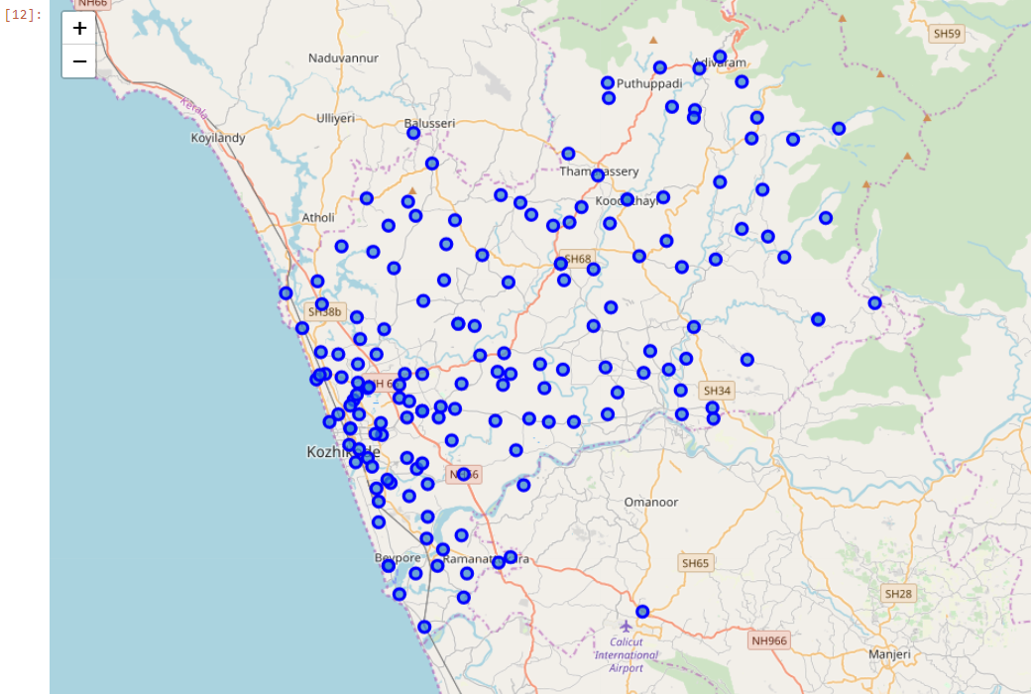
Kozhikode Area in Kozhikode

Slide 8
Foursquare API is used to get venues at surrounding area of both Taliparamba, Kannur and Kozhikode area.
The following for each Area were analyzed
1st Most Common Venue
2nd Most Common Venue
3rd Most Common Venue
4th Most Common Venue
5th Most Common Venue
6th Most Common Venue
7th Most Common Venue
8th Most Common Venue

Slide 9
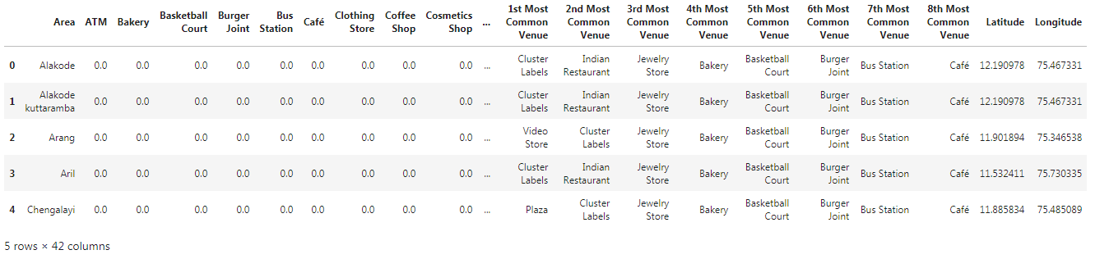
K-Mean cluster :Kannur
3 clusters were set for Kannur and K-mean is implemented on these clusters

Slide 10
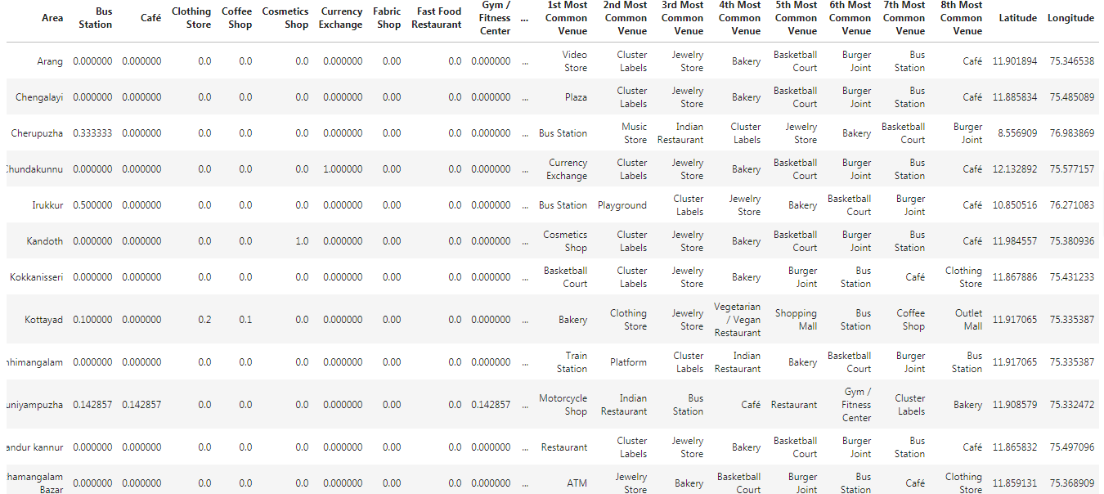
Kannur: Cluster 1

Slide 11
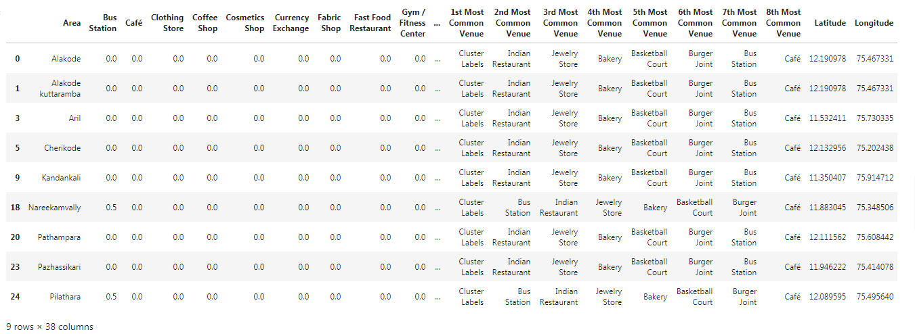
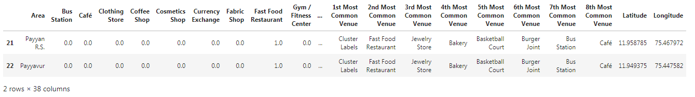
Kannur: Cluster 2
Kannur: Cluster 3

Slide 12
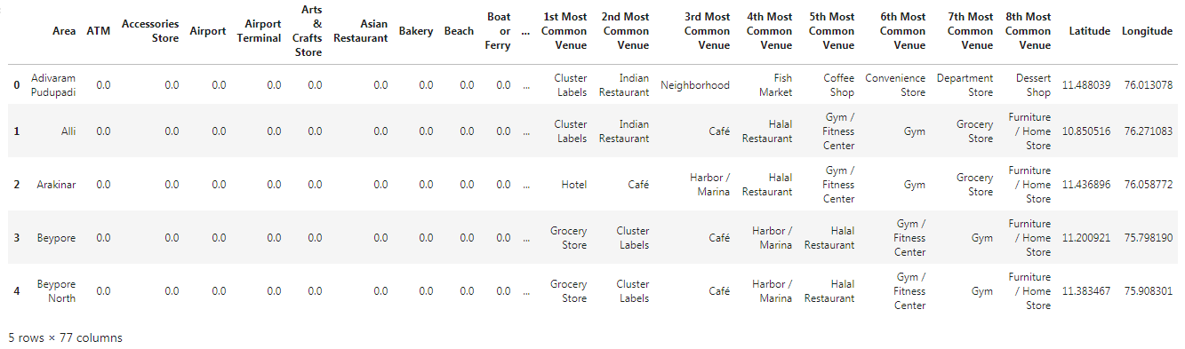
K-Mean cluster :Kozhikode
3 clusters were set for Kozhikode and K-mean is implemented on these clusters

Slide 13
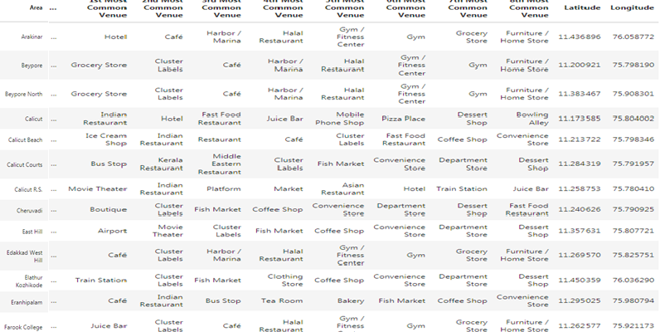
Kozhikode: Cluster 1

Slide 14
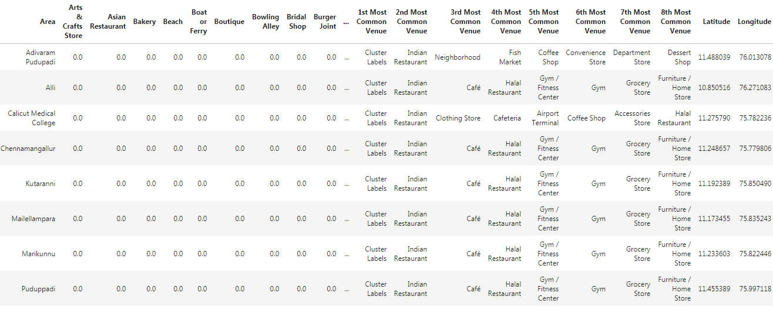
Kozhikode: Cluster 2

Slide 15
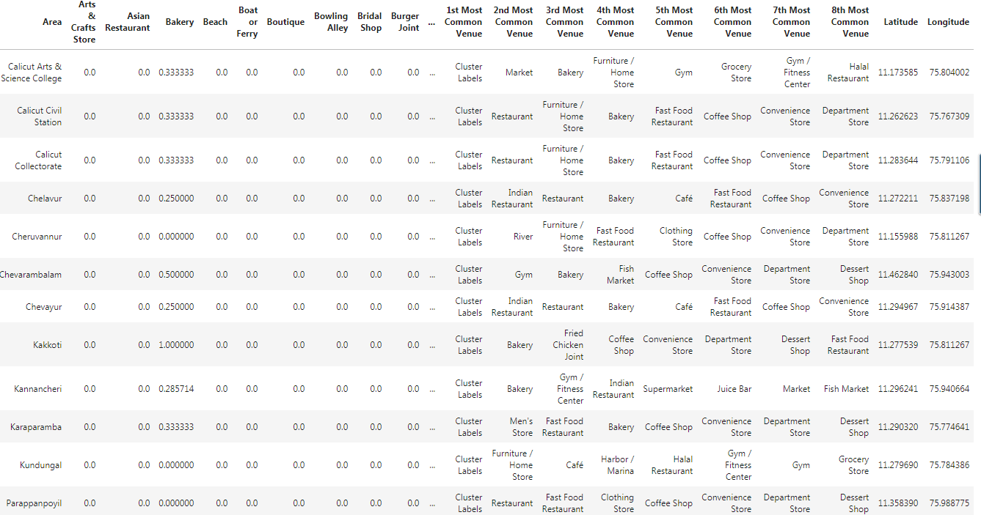
Kozhikode: Cluster 3

Slide 16
Discussion
Based on cluster for each cities above, we believe that classification for each cluster can be done better with calculation of venues categories (most common) in each cities. Referring to each cluster, we can't determine clearly what represent in each cluster by using Foursquare - Most Common Venue data.
However, for the sake of this project we assumed each cluster as follow:
Cluster 1: Kannur: Tourism
Cluster 2: Kannur: Residential
Cluster 3: Kannur: Mix
Cluster 1: Kozhikode: Tourism
Cluster 2: Kozhikode: Residential
Cluster 3: Kozhikode: Mix
What is lacking at this point is a systematic, quantitative way to identify and distinguish different district and to describe the correlation most common venues as recorded in Foursquare. The reality is however more complex: similar cities might have or might not have similar common venues. A further step in this classification would be to find a method to extract these common venues and integrate the spatial correlations between different of areas or district.
We believe that the classification we propose is an encouraging step towards a quantitative and systematic comparison of the different cities. Further studies are indeed needed in order to relate the data acquired, then observe it to more meaningful and objective results.

Slide 17
Conclusion
Using Foursquare API, we can captured data of common places all around the world. Using it, we refer back to our main objectives, which is to determine; the similarity or dissimilarity of both cities classification of area located inside the city whether it is residential, tourism places, or others
In conclusion, both cities Kannur and Kozhikode are the center of attraction among Kerala. However, to declare both cities are similar or dissimilar base on common venues visited is quite difficult. Both cities is similar in some venues also dissimilar in certain venues. And for classification based on common venues, again we must have more systematic or quantitative way to identify and declare this. Comparison can be made, but no such method or quantitative data to determine this. We hope in the future, a method to determine it can be establish and explore for references.
Thank you,
Sharika
Kannur

